Slide 1
Beer Restaurant Success
The Hermitage Group
Samantha Wright, Ryan Walkley, Andrew Holt, and Hanna Kim

Slide 2

Selected Topic:
Predicting success of beer-serving businesses; what makes them successful
Reason for selection:
Want to know where to open our beer serving restaurant - The Hermitage
Notes:
Project Overview

Slide 3

Main Dataset: Beer_Permit_Locations.csv
Displays beer-serving business permit information [1]
Data is specific to businesses in Nashville area - i.e., Davidson County [1]
Data provided by Beer Permit Board [1]
Administrates “all laws and ordinances relating to beer and like alcoholic beverages” [3]
Obtained from Data.Nashville.gov
Publicly accessible data portal containing datasets related to various Nashville businesses, agencies, and departments[2]
Notes:
Data is active permits administered by the Beer Permit Board
Total active permits: 1,305 (before cleaning)

Slide 4
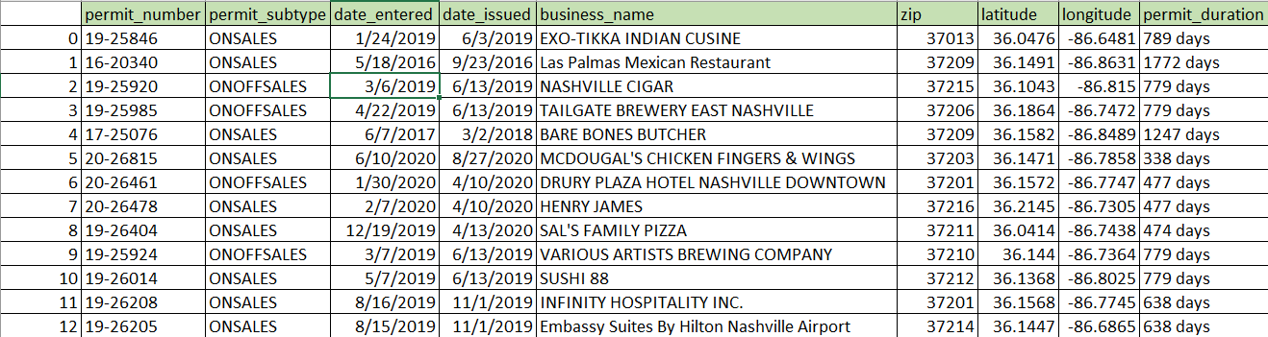
Variables of Interest - Beer Permit Data
Notes:
permit_number: permit unique identifier
permit_subtype: On-sale vs off sale vs on/off sale vs special - we are interested in on and on/off
permit_duration: number of days business has held permit
Calculated by subtracting date_issued from present day date

Slide 5
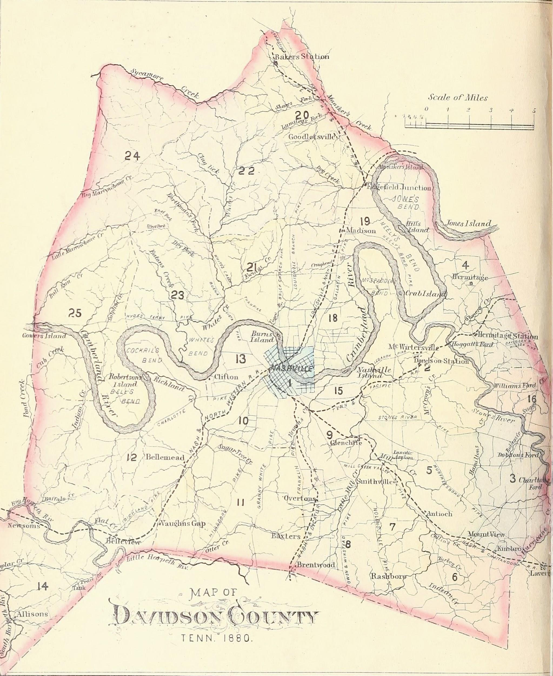
demographics_by_zip.csv
Displays various demographic data for every zip code area in Davidson County except one
Race
Gender
Age
Etc.
Data provided by United States Census Bureau
“[Their] goal is to provide the best mix of timeliness, relevancy, quality and cost for the data [they] collect and services [they] provide” [4]
Obtained from Census.gov
“Provid[es] current facts and figures about America’s people, places, and economy” [4]
Notes:
Age was one of the leading factors of our demographic analysis - consumers between the age of 21-34 frequent beer serving establishments more than any other age group (SBDC.org)

Slide 6

education_by_zip.csv
income_by_zip.csv
Displays education levels for different demographic groups found in Davidson County
Data provided by United States Census Bureau
Obtained from Census.gov
Displays different income types for different demographic groups found in Davidson County
Household income
Per Capita Income
Etc.
Data provided by United States Census Bureau
Obtained from Census.gov
Notes:
Our group focused on the Average Household income by zip code.
According to Restaurant.org, spending at restaurants is higher for families with higher household incomes.

Slide 7
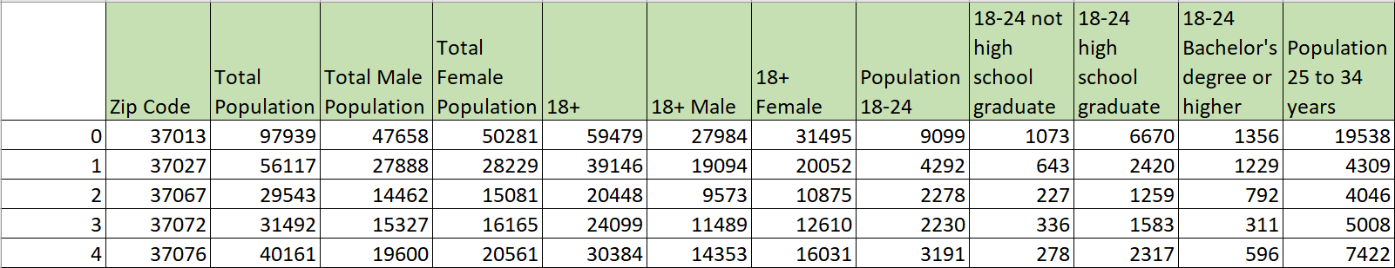
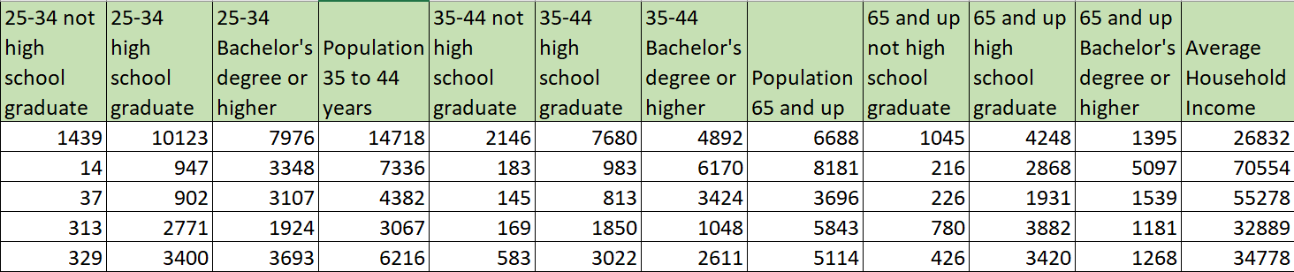
Variables of Interest in Merged Demographic Dataset
Notes:
Demographics data can be used to focus your search for a location to open your specific restaurant.

Slide 8

Question to Answer
Based off of beer permit and demographic data, in which zip code will one be more successful when opening a beer serving establishment in Davidson County?
Notes:
Using the previously mentioned beer permit and demographic datasets, we hoped to discover in which zip code one would be more successful when opening a beer serving establishment in Davidson County.

Slide 9
Data Exploration Process
Notes:
Now I will discuss the initial steps we took to explore our datasets and start setting up our database and machine learning model.

Slide 10
Main Dataset Search
Found Beer_Permit_Locations.csv dataset on Data.Nashville.gov
After download, had following variables:
Notes:
After we found the Beer_Permit_Locations dataset on Data.Nashville.gov, we downloaded it and uploaded it to our repository.
After the initial download, the dataset had the following variables (point out the green rows in the screenshots)
While many of the variables were indeed helpful for answering our questions - like Permit SubType and Date Issued - some of them needed to be transformed - like the Mapped Location variable - while other variables needed to be removed entirely.

Slide 11
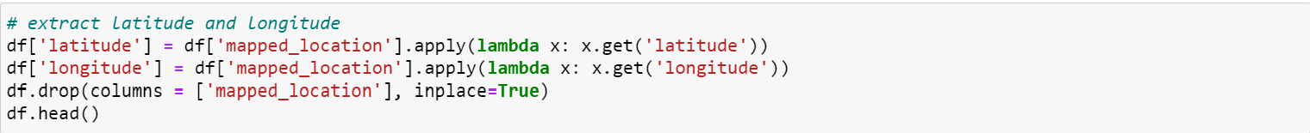
Main Dataset Cleaning and Transformation
Imported dataset into jupyter notebook as dataframe
Pandas was used to clean and transform dataset
Searched for and removed duplicates
Rows with null values dropped
Columns with irrelevant data were removed
longitude and latitude column values were extracted from Mapped Locations column values
Mapped Locations column subsequently deleted
permit_duration values calculated and added as column to dataset
Notes:
And so, the cleaning and transformation process began.
In order to do this, we imported the dataset to jupyter notebook as a dataframe and imported pandas as a dependency.
Then, we found and removed duplicates in the dataset using the code seen here (point it out with pointer)
Next, we removed rows with null values using the dropna() method
After that, we removed all the columns that were not relevant to our question of interest
To be clear, the screenshot shows the code we used to drop one of the unnecessary columns.
All the unnecessary columns were removed using the methods shown in this screenshot.
Moving on to transformation, the latitude and longitude values were extracted from the values in the Mapped Locations column using the lambda function in the screenshot, and the Mapped Locations column was subsequently deleted.
This was done in order to create heat map visualizations for our dashboard and analysis.
Then, permit duration values were calculated using the code shown here (point to last screenshot with pointer) and added to the dataset in the column permit_duration

Slide 12
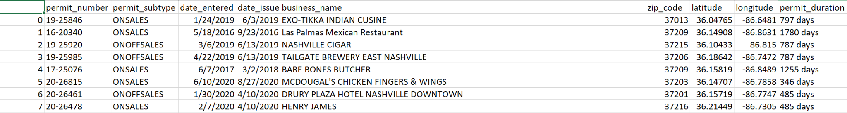
Main Dataset Export
New, cleaned dataset exported as beer_permit_data_V1.csv
Notes:
Lastly, we exported the cleaned dataset as beer_permit_data_v1.csv, a snapshot of which can be seen here.
As you can see, this cleaned dataset has much fewer columns than the original.

Slide 13

Database and Machine Learning Model Creation
Created RDS instance and S3 bucket in AWS
To allow data in database to be accessed by all group members
Connected pgadmin to RDS instance
Created tables to hold beer_permit_data_V1.csv data
Used jupyter notebook to fill in pgadmin tables with beer_permit_data_V1.csv data
Used jupyter notebook to create starter code for unsupervised machine learning model
Took data from database and outputted labels
Notes:
As for our database, we started off by creating an RDS instance and S3 bucket in AWS
This was done to allow all members of our group to access data in our database
Otherwise, only the member who made the database would have access to the data in the database
Next, we connected pgadmin to the RDS instance and created tables to hold the data in the beer_permit_data_V1.csv data
Finally, we utilized jupyter notebook to fill the pgadmin tables with the beer permit data
The last thing we did in this initial setup phase is create starter code for our unsupervised machine learning model.
At this point in our project, the code basically took data from our database and outputted labels

Slide 14
Data Analysis Process

Slide 15

Additional Database Setup
Finished transforming beer_permit_data_V2.csv dataset
Found 3 census datasets for Davidson County from census.gov
Covered general demographic, education, and income information
Each dataset cleaned individually then merged into single dataset
Done using jupyter notebook
Added cleaned, merged census dataset to postgres database
Also added it to another S3 bucket for public use
Utilized Pyspark to connect database to ML model using Google Colab
Notes:
After the initial test data set taken from the beer permit data from data.nashville.gov, additional cleaning was required to remove empty rows and values. This reduced the dataset to the final size of 1306 rows indexed on unique permit number values. Added an API feature to pull updated permit data from data.nashville.gov.
Census data includes population, average income by zip code, and education levels. Total population has sub groups of male and female, and divisions of total 18+, and 10 your groups starting with 18-24 y/o. Education is grouped by not high school, high school, and bachelors or higher for each 10 year age range. The data is indexed on unique zip code values.
The datasets were set up in PostgresSQL with a foreign key relationship on zip code in PGAdmin and joined on zip code. The joined dataset was added to an S3 bucket in AWS. The schema is available in the repo.
Pyspark to pull data from S3 buckets.

Slide 16
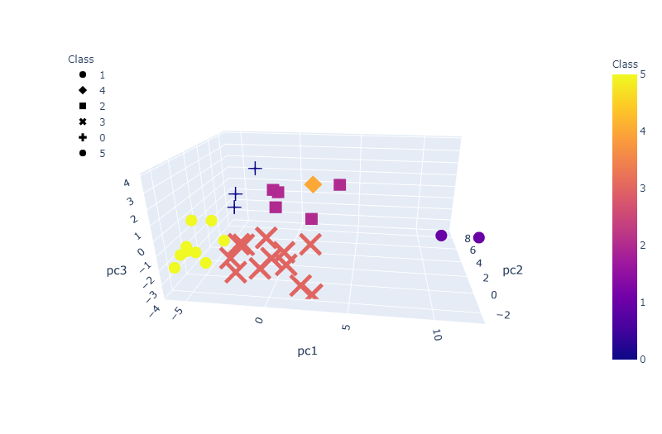
Machine Learning Model
Clustering model grouped data but did not answer question
Notes:
Pyspark was utilized in google colab to pull data from the database. We initially believed an unsupervised clustering model would present the information necessary to make predictions to answer our main question. Utilizing principal component analysis(PCA) to standardize the features (21 features including population age groups, education, income) and get “dummies” to categorize zip code and permit numbers as binary features. The model adequately clustered the data. The visualized grouping of data, as seen here, does not sufficiently identify those features that contribute to the correlation. It does indicate a good correlation between features, and further analysis would be required. Our goal was to identify the orange X and yellow Diamond from the visualization above.

Slide 17
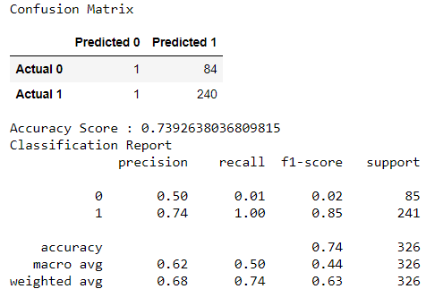
Machine Learning Model
Made random forest model to answer question
Achieved sufficient accuracy
Notes:
Changed model to supervised- clustering model. Used PCA to combine and standardize features into a Random Forest model.
Supervised learning was selected for this task. Random Forest was selected for its ability to handle multiple features and large datasets by randomly sampling each feature. These models resist overfitting and can rank the importance of input variables.
Feature engineering: the data lacked a “success” feature. Finance data or not-renewed beer permit data was not available. We created binary classifier for success based on more than 2 years permit duration.
Features for this model were slowly limited by the ranking of features through trial and error within the model.
The current accuracy of the model is 74%. Further tuning may be needed to improve this number, if possible. However, trial and error in feature selection has been performed to achieve the current result. For the purposes of business success probability, this model is sufficiently accurate.

Slide 18

Dashboard Creation
Imported beer_permit_data_V2.csv and merged demographic datasets to Tableau
Created visualizations for analysis
Created dashboard explaining our topic and results
https://public.tableau.com/views/Beer_Restaurant_Success_Visualizations_16288178489470/BeerSuccess?:language=en-US&publish=yes&:display_count=n&:origin=viz_share_link
Notes:
Using the data output from the Data Exploration Process, we used Tableau to create multiple interactive visualizations to display our data analysis results. Included in each of the visualizations are filters that can be used in order to display specific data. The data displayed can be narrowed down by zip code, type of permit, and age group. (SHOW DASHBOARD)

Slide 19
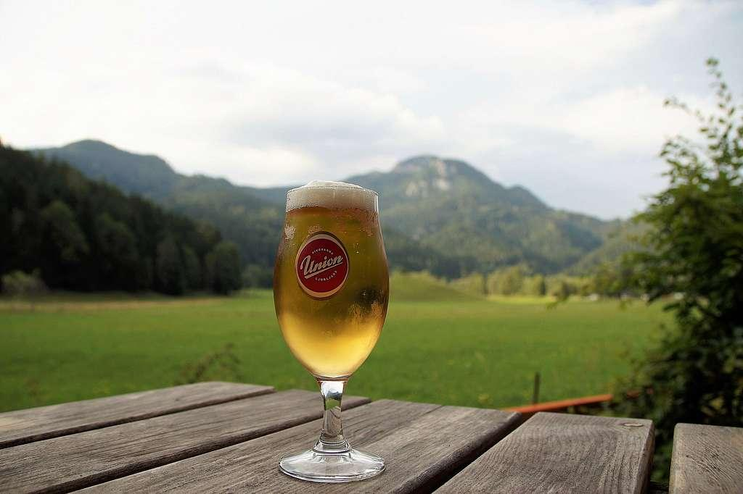
Results of Analysis
Further vicinity from downtown Nashville = longer permit duration
Data is limited to current active permits in Davidson county
When establishing business away from downtown Nashville, need to consider desires of local populations
Certain zip codes have higher concentrations of certain demographic groups
Ex. 37013/37211 have highest concentration of 25-34 year olds
Ex. 37205/37215 have highest household income
Different demographic groups have different desires
Notes:
With the visualization, we were able to determine that the further a beer selling establishment is from Downtown Nashville, the longer the beer permit has been active.
Another interesting finding, is that the higher the income level within a given zip code, the fewer the beer serving establishments there are.

Slide 20

Future Analysis Recommendations
Addition of Review Data (Yelp, Google) to join with the permit data
Addition of Revenue Data to join with the permit data
Notes:
When looking at the measure of “success”, there are many different ways to measure that. In our analysis, we used active permit duration (by days) to measure success. For future analysis, we could recommended using multiple different measures of success. On top of active permit duration, using other datasets such as review data (Yelp or Google) and Revenue data.

Slide 21
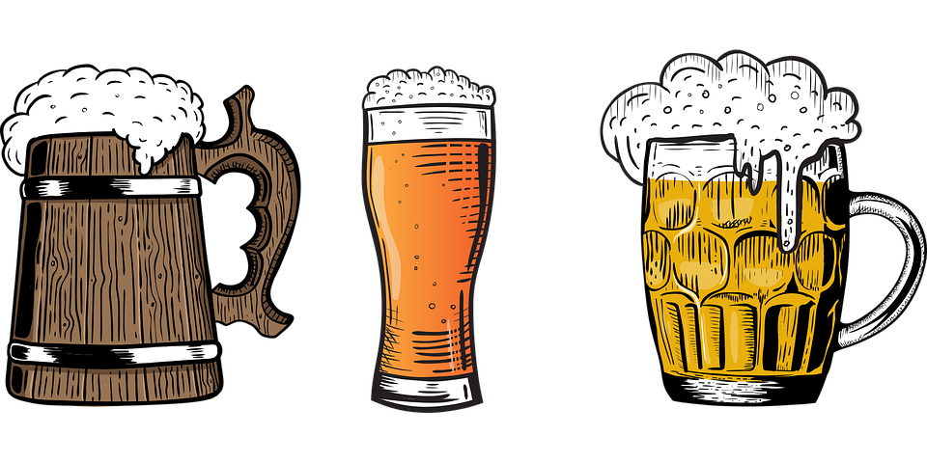
Things We Would’ve Done Differently
Rent data by zip code
Map hotel and short term rentals
Experimented with additional machine learning models
Notes:
When looking back at our project, there are a few things that we would have done differently.
First, finding and adding rent data by zip code.
Another would be alongside our current data using hotel and short term rental datasets and mapping them. According to visitmusiccity.com, in 2019 there were 16.1 million visitors to Nashville. If an establishment were looking for a new location to open and be successful, having this data available could be impactful.
Also taking time and experimenting with additional machine learning models.

Slide 22

Technologies Used
Data cleaning and analysis:
Pandas for cleaning and transforming data and exploratory analysis
Python for further analysis
Database storage
Postgres
Flask for data display
AWS
RDS instance for connection to pgadmin
S3 buckets
Machine Learning
Sci-kit Learn
Dashboard
Tableau
Notes:
Listed are all the technologies we used throughout each step of our project.

Slide 23
Sources
https://data.nashville.gov/Licenses-Permits/Beer-Permit-Locations/3wb6-xy3j
https://data.nashville.gov/
https://www.nashville.gov/Government/Boards-and-Committees/Committee-Information/ID/53/Beer-Permit-Board.aspx
https://www.census.gov/

